Slide 1
Warm Up
As of 2015, what percentage of American workers are employed full time? Part time?
What was the original minimum wage? Is minimum wage a price floor or price ceiling?
What is a base year? In regards to a base year, what is an outlier?
What is a set aside contract? What is an example?
What is the Glass Ceiling? What two groups does this have the most impact on in the United States?
What is the two tier wage system? Name a company that uses this system.
CEQ: What is Corporate Inversion? What two pharmaceutical companies cancelled their merger due to the criticism of Corporate Inversion?

Slide 2
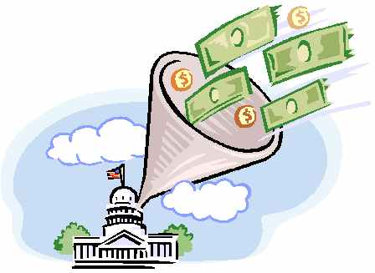
Chapter 9
Spring 2016

Slide 3

The Economics of Taxation
Sin Tax – A relatively high tax designed to raise revenue and reduce consumption of a socially undesirable product
  Ex) Liquor, Tobacco
Incidence of Tax – The final burden of the tax
Tax Loopholes – Exceptions or oversights in the tax law that allow some people and businesses to avoid paying taxes.
  Ex) Many corporations paid $0 in income taxes over the last 15 years

Slide 4
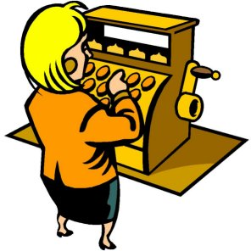
The Economics of Taxation
Individual Income Tax – The tax on peoples earning’s.
  Ex) money that comes out of your paycheck
Sales Tax – A general tax levied on most consumer purchases
  Ex) $.99 cent product actually costs $1.07

Slide 5
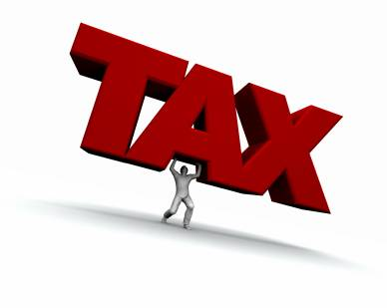
The Economics of Taxation
Withholding Tax – Interest free loan for the government. Some paid back with a tax return.
Benefit Principle of Taxation – Those who benefit from government goods and services should pay in proportion to the amount of benefits they receive.

Slide 6
The Economics of Taxation
Ability-to-Pay Principle of Taxation – The belief that people should be taxed according to their ability to pay regardless of the benefits they receive.
Proportional Tax – Same Percentage Rate to everyone regardless of income
  Ex) Flat Tax
Average Tax Rate – Total taxable income divided by the total income.
  Ex) If I make $52,000/year I really make $36,000

Slide 7
Warm Up
Compare and Contrast the Ability-to-Pay Principle of Taxation with the Benefit Received Principle of Taxation.
What is a withholding tax? Where is it taken from? When did it begin and why?
What is a Sin Tax?
Is Sales tax a local, state or federal tax?
Is Income tax a local, state or federal tax?
What is a tax loophole?
CEQ: What is Corporate Inversion? What two pharmaceutical companies cancelled their merger due to the criticism of Corporate Inversion?
Notes:
Pfizer and Allergen

Slide 8
The Economics of Taxation
Progressive Tax – A tax that imposes a higher percentage rate of taxation on persons with higher incomes.
  Ex) United States
Marginal Tax Rate – The tax rate that applies to the next dollar of taxable income, that increases.
  Ex) $1,000 tax on $10,000, $4,000 tax on $20,000, $30,000 tax on $100,000
Regressive Tax – A tax that imposes a higher percentage rate of taxation on low incomes than on high incomes.

Slide 9
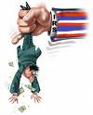
The Federal Tax System
16th Amendment – Allowed Congress to levy an income tax.
IRS – Internal Revenue Service – The Branch of the U.S. Treasury Department in charge of collecting taxes.
  Tax Return – An annual report to the IRS summarizing total income, deductions, and the taxes withheld by employers.
Notes:
There are four things you shouldn’t mess with in the United States…The Mafia, Your In-Laws, The IRS and the IRS.

Slide 10

The Federal Tax System
Indexing – An upward revision of the tax brackets to keep workers from paying more in taxes just because of inflation.
FICA – Federal Insurance Contributions Act (Also known as payroll tax) – Set up to pay Social Security and Medicare
Medicare – Federal Health Care program available to all senior citizens, regardless of income.
Notes:
There are four things you shouldn’t mess with in the United States…The Mafia, Your In-Laws, The IRS and the IRS.

Slide 11
Warm Up
What is a progressive tax? Graph it.
What is a regressive tax? Graph it.
What is Income Tax? Is it progressive, regressive or flat?
What is Sales Tax? Is it progressive, regressive or flat?
What is a Sin Tax?
What is a proportional tax?
What is the benefit principle of taxation?
What does a tax do to the supply/demand curve? Graph it

Slide 12
The Federal Tax System
Corporate Income Tax – The tax a corporation pays on its profits
Excise Tax – A tax on the manufacture or sale of selected items.
  Ex) Gas, Liqour
Luxury Tax – Additional tax on expensive items. Phased out in 2003
Estate Tax – Tax the government levies on the transfer of property when a person dies
  Only if the home is worth more than $2 million

Slide 13

The Federal Tax System
Gift Tax – A tax on donations of money or wealth and is paid by the person who makes the gift
  Designed to make sure that rich people do not give away their valuable goods to avoid paying a tax on them.
Customs Duty – A charge levied on goods brought in from other countries.

Slide 14
Chapter 10
Per Capita – Per Person
Public Sector – The part of the economy made up of federal, state and local governments
Private Sector – The part of the economy made up of private individuals and privately-owned businesses
Transfer Payment – A payment for which the government receives neither goods nor services in return
  Ex) Social Security, Welfare, Unemployment

Slide 15
Chapter 10
Grant-in-aid – A transfer payment made by one level of government to another
  Ex) Interstate Highways
Distribution of Income – the Way in which income is allocated among families, individuals, or other designated groups in the economy
Distribution of Wealth – Same as above, but also includes investments and assets
  The gap is 10 times greater with wealth than income

Slide 16
Warm Up
What is the Private Sector?
What is the Public Sector?
What does Per Capita mean? Why is it important?
What is an excise tax?
What is wealth distribution?
What is income distribution?
Which has a greater gap between the top tier and the bottom tier?
CEQ: What major telephone service went on strike today (40 k employees)? What do they want?

Slide 17
Chapter 10
Federal Budget – An annual plan outlining proposed revenues and expenditures for the coming year.
Mandatory Spending – Spending authorized by law that continues without the need for approval by congress
Discretionary Spending – Programs that need yearly approval
Federal Budget Activity…

Slide 18
Activity Reaction
Write (½ - 1 page) about:
What was your highest discretionary spending allocation? What was your lowest? (personal budget)
Compare and contrast your guesses versus the actual amounts? (personal budget)
Compare and contrast the actual budget with your budget? (group budget)
What are your justifications for your decisions? (group budget)
Is it easy to shrink the federal budget? Explain

Slide 19
Chapter 10
Fiscal Year – Any 12 month financial planning period
Deficit – an excess of expenditures over revenues
Surplus – an excess of revenues over expenditures
Appropriations Bill – An act of Congress that allows federal agencies to spend money for specific purposes
  This is heavily abused by congress to use “Pork Barrel” spending
Medicaid – A joint federal-state medical insurance program for low-income people

Slide 20
Chapter 10
Balanced Budget Amendment – A constitutional amendment that requires that annual spending not exceed revenues
  Ex) California
Intergovernmental Expenditures – Funds that one level of government transfers to another level for spending
Deficit Spending – Spending more money than you make

Slide 21
Chapter 10
Federal Debt – The total amount borrowed from investors to finance the government’s deficit spending
  1900 - $ 1.3 Billion
  1929 - $16.9 Billion
  1940 - $50.7 Billion
  1988 – 2.5 TRILLION
  1999 - $5 TRILLION
  2006 - $5.6 TRILLION
  2008 – 10.9 TRILLION
  2009 - $ 11.6 TRILLION – Enough to stretch $1 bills to the sun and back 8 times
  2016 - $19 TRILLION
  2017 - $20 TRILLION and counting
    New budget and tax proposals would see this number grow to $29 TRILLION over the next 8 years

Slide 22
Chapter 10
Balanced Budget – An annual budget in which expenditures are equal to revenues
Trust Funds – Special accounts used to fund specific types of expenditures such as Social Security and Medicare
Crowding-Out Effect – The higher than normal interest rates that heavy government borrowing causes
Pay-as-you-go Provision – A requirement that new spending proposals or tax cuts must be offset by reductions elsewhere

Slide 23
Chapter 10
Line-item Veto – The power to cancel specific budget items without rejecting the entire budget
  Voted unconstitutional in 1996 by the Supreme Court
Spending Caps – Legal limits on annual discretionary spending
Entitlements – Broad social programs that use established eligibility requirements to provide health, nutritional, or income supplements to individuals

Slide 24
Warm Up
What is a glass ceiling?
What is minimum wage?
What’s a giveback?
What is an injunction?
What is a Sin Tax?
What are entitlements? What is another name for entitlements?
What is larger? The federal deficit or the federal debt?
What is “Pork Barrel” Spending? Name a real life example.
CEQ: What is the leading cause of truck driver fatalities and what type of technology could solve this problem?

Slide 25
III. Characteristics of a Good Tax
1. Equity- a tax has to be fair
  Loopholes
  Different types of taxes:
  Benefit principle of taxation
    Toll Roads
  ‘ ability to pay’ principle
    Progressive income tax

Slide 26
Characteristics of a Good Tax
2. Simplicity- a tax has to be easy to understand
  Indiv. Income tax (complicated)
    This is why people don’t like the IRS
  Sales tax
    Much easier to understand

Slide 27
Characteristics of a Good Tax
3. Efficiency- Ease of administration and successful at generating revenue
  Indiv. Income tax
    How is it collected
    What is an inefficient tax?

Slide 28
All Content Created by DJ Cook

